Slide 1

Heredity and Evolution
An Illustration Of Evolution - Situation 2

Slide 2

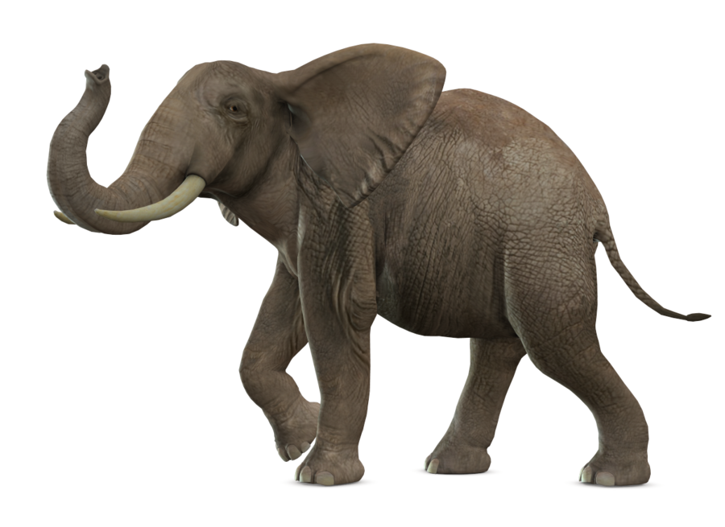
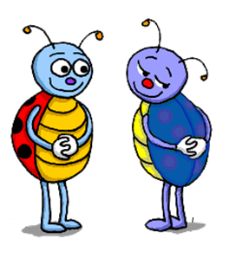
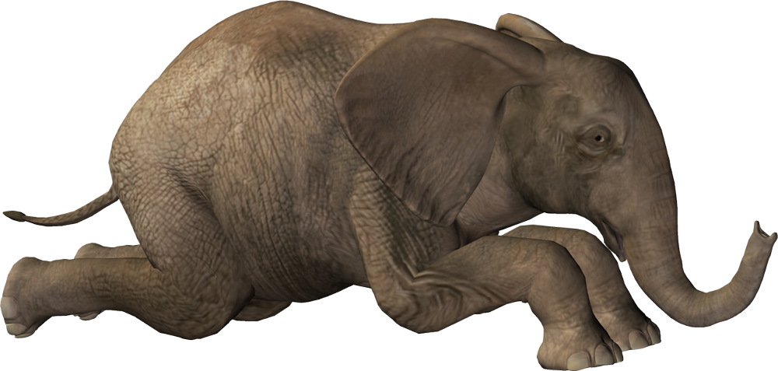
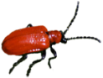
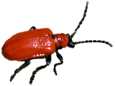
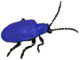
An illustration of evolution
Situation 2
Their population will grow by sexual
reproduction, and therefore, can generate variations.
A colour variation arises during reproduction,
so that there is one beetle that is blue in colour instead of red.
What started out as a rare variation
came to be a common characteristic in the population
But at this point elephants comes by, and stamps on the bushes where beetles live .
Red and blue beetles
Reproduce and pass the blue colour to its offspring.
The beetle population slowly expands again, but now, the beetles in the population are mostly blue.
By chance, the few beetles have survived.
This kills most of the beetles.
They are mostly blue.

Slide 3


An illustration of evolution
From both the situations, we can state that
What started out as a rare variation
came to be a common characteristic in the population
In other words we can say
Frequency of an trait changed over generations
Number of
Character
Characters are controlled by genes, so we can say
This is the essence of the idea of evolution
Frequency of genes changed over generations

Slide 4
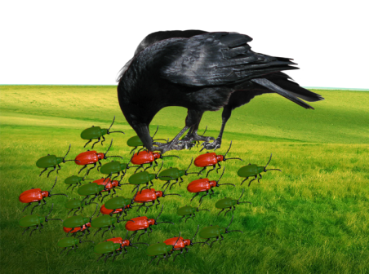
An illustration of evolution
But we can observe interesting differences, in the two situations.
Situations 1
The changes were naturally selected because it gave a survival advantage to the green beetles.
The natural selection is exerted by crows, more crows there are, the more red beetles would be eaten, and the more the proportion of green beetles in the population would be.
Thus, natural selection is directing
evolution in the beetle population.

Slide 5
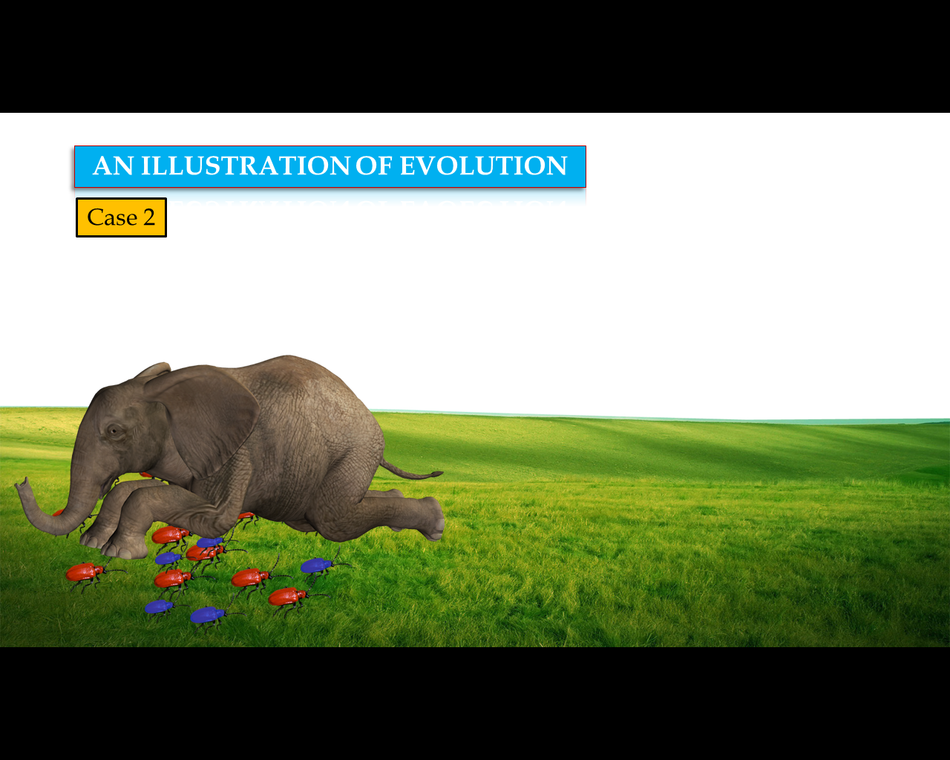
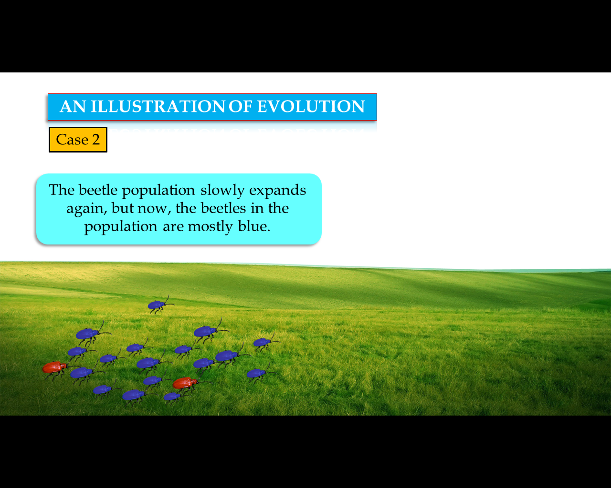
An illustration of evolution
But we can observe interesting differences, in the two situations.
Situations 2
The colour change gave no survival advantage.
It was simply a matter of accidental survival of beetles of one colour that changed the common characteristic of the resultant population.
This is called as genetic drift, which is diversity without any adaptations
So, accidents in small populations can change the frequency of some genes in a population, even if they give no survival advantage.

Slide 6
Thank You

